Slide 1
EXECUTIVE CYBERSECURITY INTELLIGENCE
Social Engineering Attacks & Human Exploitation
An executive analysis of psychological manipulation tactics, high-impact case studies, and enterprise defense frameworks.
ADVANCED THREAT VECTOR MATRIX

Slide 2


FOUNDATIONAL MECHANICS
The Human Vulnerability Surface
Exploiting cognitive bias over technical network flaws.
Artificial Urgency: Forcing immediate compliance
Authority Spoofing: Impersonating executive power
Fear Triggering: Threatening account suspension
Social Proof: Fabricating peer consensus

Slide 3



METHODOLOGY
The 4-Phase Exploitation Lifecycle
PHASE 01
PHASE 02
PHASE 03
PHASE 04
Reconnaissance
Pretexting
Exploitation
Exfiltration
OSINT targeting via LinkedIn profiles.
Constructing deceptive trust scenarios.
Harvesting credentials or MFA tokens.
Executing unauthorized wire transfers.

Slide 4

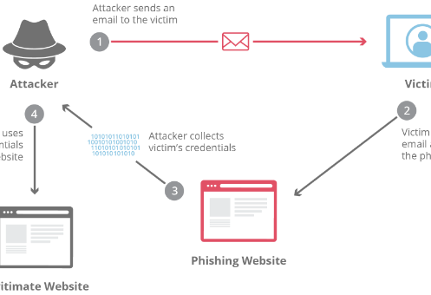

EMAIL VECTOR
Spear Phishing & Credential Harvest
Targeted Spear Phishing
Highly tailored emails leveraging internal vendor vocabulary.
REAL-WORLD CASE STUDY
Twitter Administrative Breach
Spear-phished internal staff for administrative access, compromising 130 high-profile accounts.

Slide 5
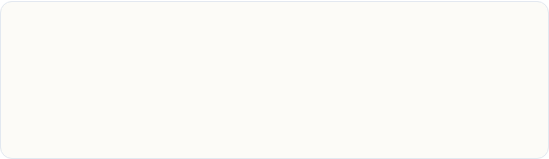

VOICE EXPLOITATION
Vishing & IT Helpdesk Impersonation
Vishing Mechanics
MGM RESORTS CASE STUDY
$100M Helpdesk Reset Attack
Attackers call helpdesks claiming lost device access.
Scatter Swine vished MGM helpdesk via 10-minute call.
Leverages employee details pulled from public LinkedIn posts.
Bypassed MFA protection, triggering casino-wide shutdown.

Slide 6


EXECUTIVE FRAUD
Business Email Compromise (BEC)
TOYOTA BOSHOKU CASE STUDY
Executive Pretexting
$37M Wire Fraud Incident
Vector: Spoofed executive email requesting urgent wire.
Spoofed executive emails convinced finance officers to change bank details.
Tactic: Fake acquisition secrecy forcing protocol bypass.
Resulted in $37 Million direct financial exfiltration.

Slide 7



AUTHENTICATION BYPASS
MFA Push Prompt Bombing
Fatigue Exploitation
Spamming targets with push notifications at 2 AM until approved.
UBER 2022 BREACH CASE STUDY
Contractor MFA Bombing
Lapsus$ spammed a contractor for 1 hour, followed by WhatsApp impersonation to gain internal network privilege.

Slide 8
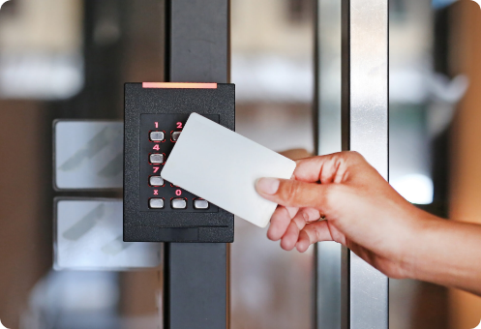

PHYSICAL THREAT VECTOR
USB Baiting & Facility Tailgating
Tailgating & Badge Piggybacking
Gaining physical entry by holding doors for polite targets.
HISTORIC INFRASTRUCTURE BREACH
Stuxnet Air-Gapped Infection
Infected USB drives dropped near facility contractor sites bridged physical air-gapped industrial controls.

Slide 9

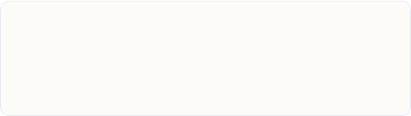
NEXT-GEN THREATS
AI Deepfakes & Synthetic Media
HONG KONG $25M DEEPFAKE BREACH
Generative AI Vectors
Multinational Video Call Scam
Real-time voice synthesis and video face-swapping.
Finance clerk joined video conference with deepfake CFO.
Eliminates grammar errors in traditional phishing emails.
Authorized 15 fraudulent wire transfers totaling $25.6M.

Slide 10
Enterprise Economic Exposure
$10.3B+
Annual global losses directly attributed to BEC and social engineering fraud.
FBI IC3 Cybercrime Report Key Metric

Slide 11

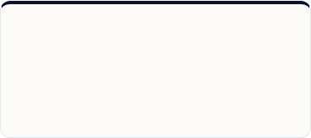
ENTERPRISE SAFEGUARDS
Strategic Resilience Framework
FIDO2 Security Keys
Out-of-Band Callbacks
Simulated Attack Labs
Hardware-bound phishing-resistant authentication keys.
Mandatory dual secondary verification for wire transfers.
Continuous adaptive phishing and vishing drills.

Slide 12
ZERO TRUST CULTURE
Verify Before You Trust
Questions & Strategic Security Discussion

Slide 13




Image Sources
https://humanfirewall.io/wp-content/uploads/2024/01/human_factor_3.png
Source: humanfirewall.io
https://www.cloudflare.com/img/learning/security/threats/phishing-attack/diagram-phishing-attack.png
Source: www.cloudflare.com
https://www.halock.com/wp-content/uploads/2024/12/DeepFake-Cybersecurity-Awareness-Risk-HALOCK-Security-copy.png
Source: www.halock.com
https://www.getgenea.com/wp-content/uploads/2024/01/shutterstock_610811747-scaled.jpg
Source: www.getgenea.com

